Slide 1
Chaser 2, Week 1
Rachel VanRyzin, Isabella Knox, 2-29-19

Slide 2
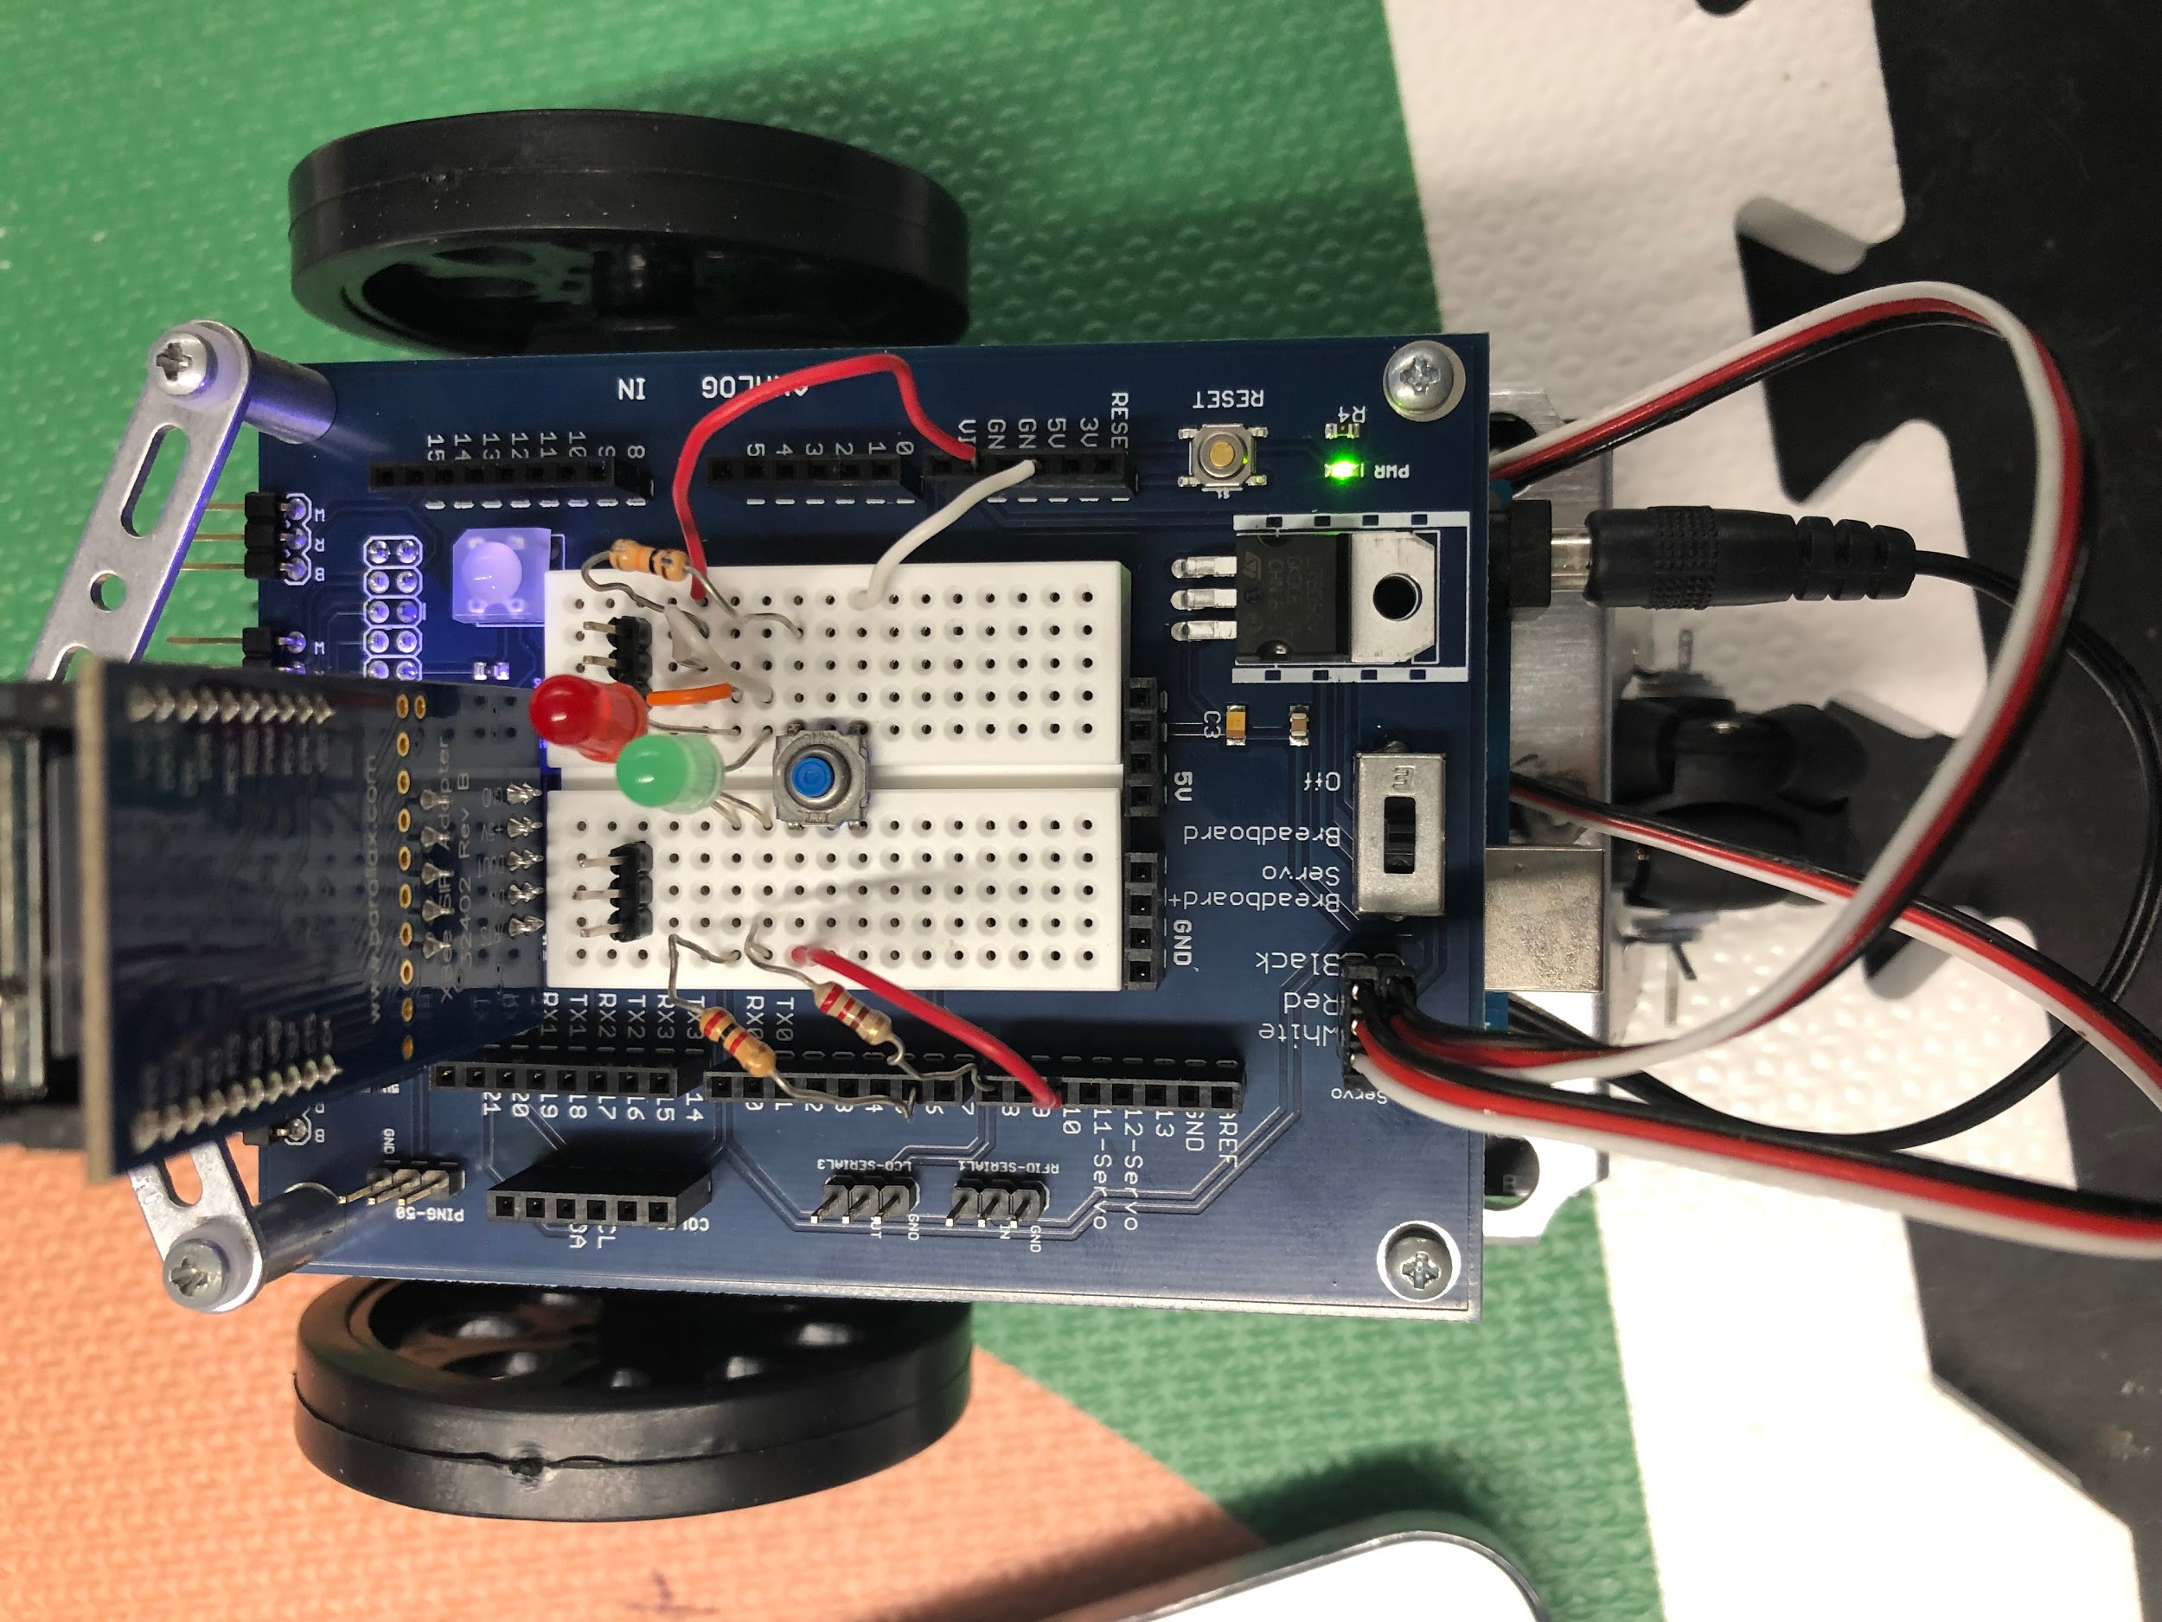
Biggest Successes
-Parts Ordered (Whisker Wires x 2, IR LED and Receiver)
-Conceptual Design Finalized
-XBee Communication Code incorporated
-Push-button/ 2 LED communication system wired

Slide 3
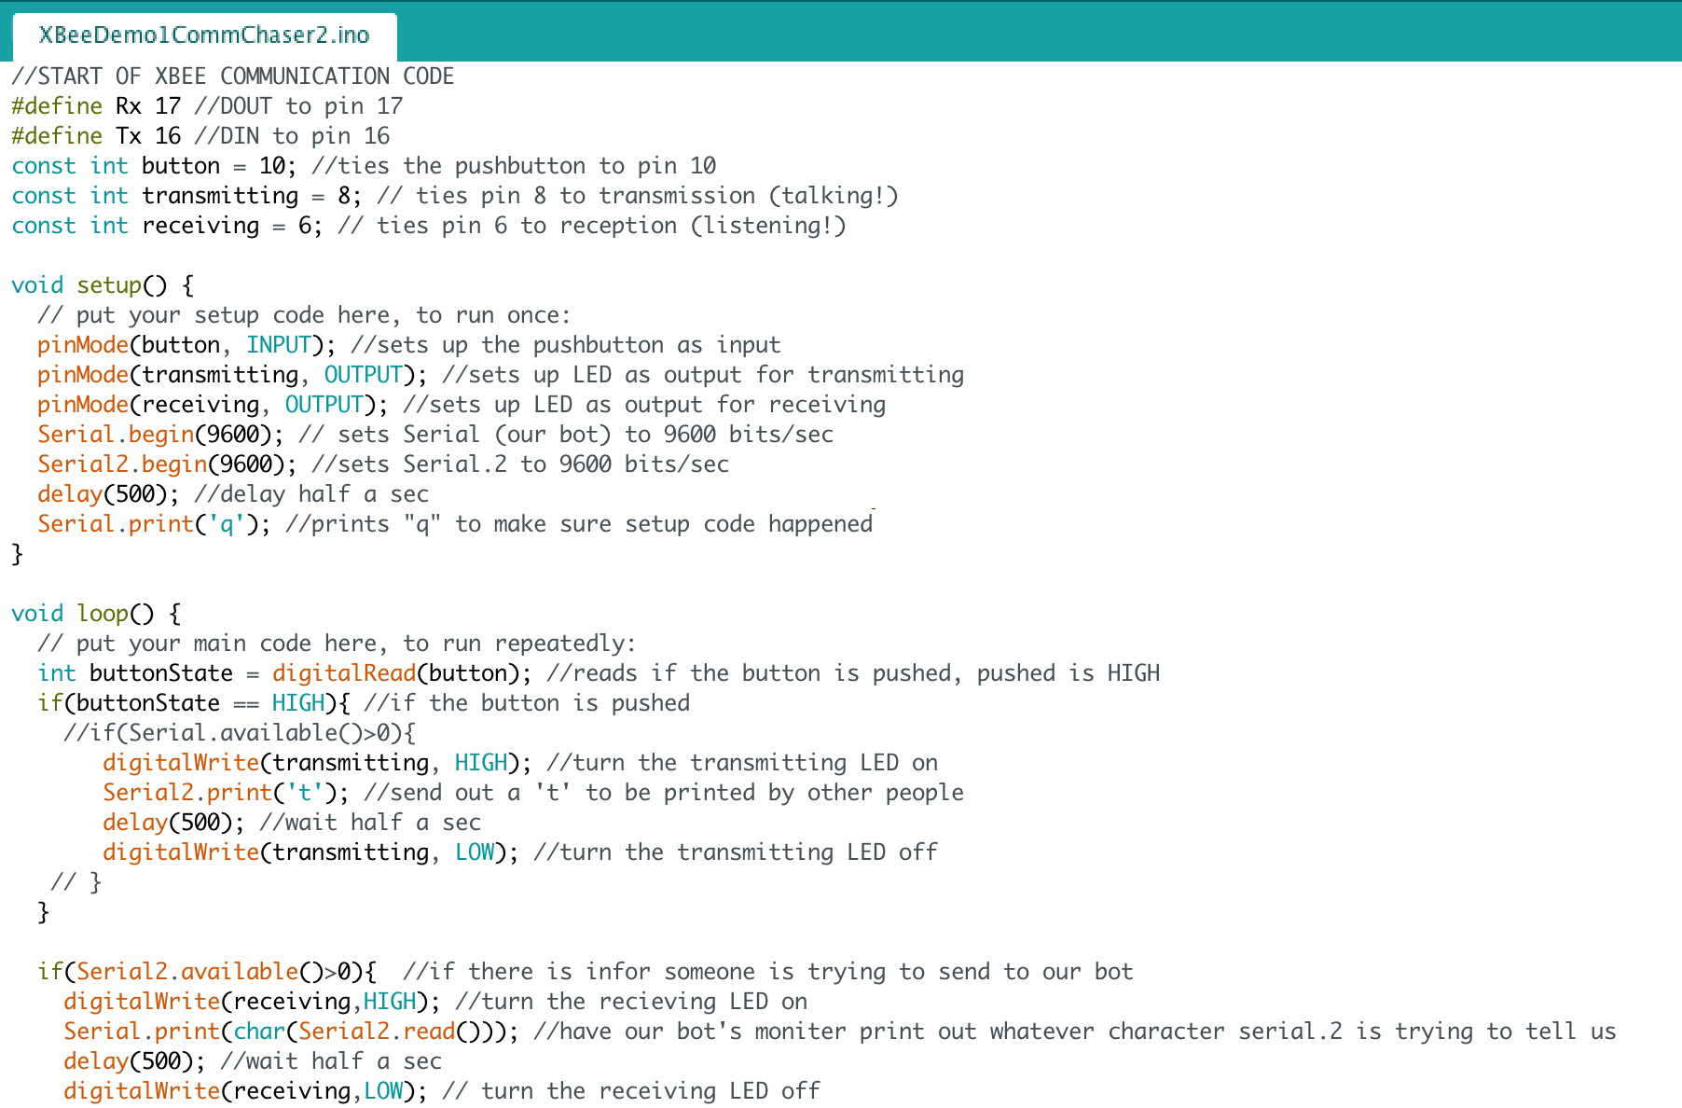
All New Code (XBee Comm)

Slide 4
Biggest Challenges
-Whisker Wires
❌ XBee is directly in the way of where the whisker wires need to touch
✅ We’ll try to rig the whisker wires around the XBee using brackets
-Funky wiring
❌ Originally, the bot was wired super messily, comm wiring didn’t work
✅ Start from scratch, will worry about whiskers after comm

Slide 5
Next Week
-Line following with QTR sensor
-Code for line following
-Begin installation of whisker wires

Slide 6
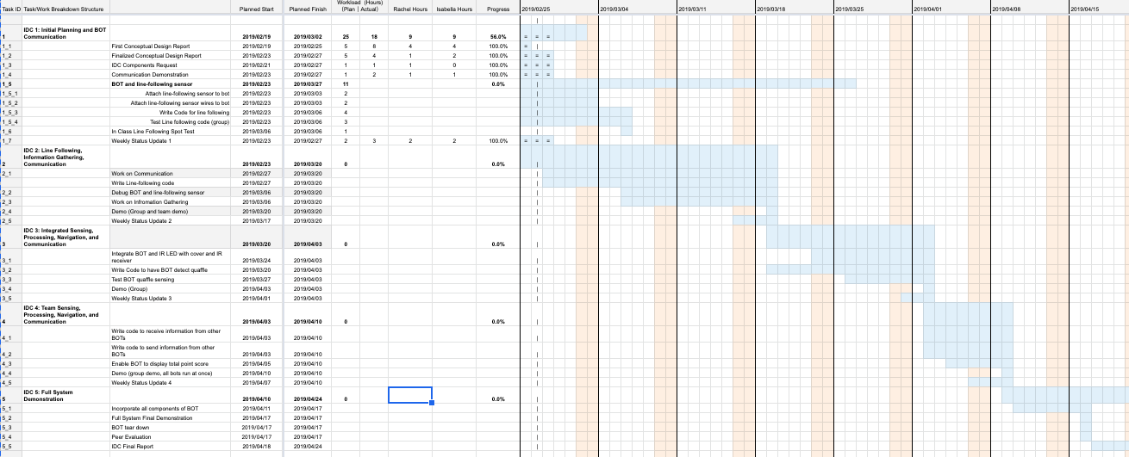
Gantt Chart

Slide 7
Cost Added This Week
Communication Gear
XBee x 1 ↠ $22.99
Red LED x 1 ↠ $0.32
Green LED x 1 ↠ $0.32
Push-button x 1 ↠ $0.50
Wire, ~ 0.5 feet ↠ $0.04
Resistor, 10 Kᘯ ↠ $0.10
Resistor, 220ᘯ x 2 ↠ $0.10 x 2 = $0.20
TOTAL COST ADDED THIS WEEK: $ 30.33
Whisker Wires Sensor
Whisker wires (pair) ↠ $3.00
1/4" 4-40 pan head screw x 4 ↠ $0.04
7/8" 4-40 pan head screw x 2 ↠ 0.06
nylon washer (screw size #4) x 2 ↠ $0.14
1/2" round stainless steel spacer x 2 ↠ $2.60
4-40 pan zinc-plated nut x 2 ↠ $0.02

